Slide 1


SQL PROJECT: RCB - IPL STRATEGY
Presented by:
Sahil Patil

Slide 2

PROBLEM STATEMENT
You have been appointed as a sports data analyst for RCB, tasked with identifying top-performing and cost-effective players ahead of the 2017 mega auction.
OBJECTIVE
Your objective is to develop data-driven strategies and actionable insights that will help the franchise build a competitive and well-balanced squad.

Slide 3
DATA OVERVIEW
Core Entities:
Player: Details about players (ID, name, role).
Match: Information on matches (ID, date, winner, venue).
Team: Teams participating in the IPL (ID, name).
Venue: Locations of matches (ID, name, city, country).
Performance Tracking:
Ball by Ball: Events for each ball (runs, wickets, player involvement).
Wickets Taken: Dismissals (bowler, fielder, player out).
Extra Runs: Extra runs conceded (wides, no-balls).
Match Outcomes:
Outcome: Match results (winning team, outcome type).
Win By: Method and margin of victory.
Player Awards:
Season: Season details and awards (Man of the Series, Orange Cap, Purple Cap).
Rolee: Player roles and skills.
Supporting Entities:
City & Country: Geographical context for venues.
Umpire: Details about match officials.
Toss Decision: Outcome of the toss.

Slide 4
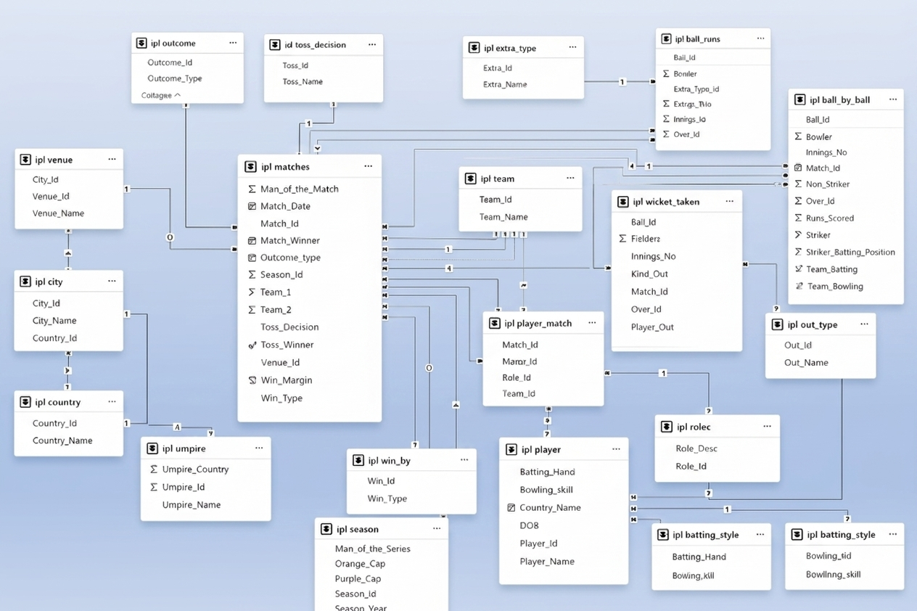
DATABASE SCHEMA

Slide 5
METHODOLOGY
Data Understanding & Cleaning: Explored and cleaned data, handling missing values and standardizing team names.
Data Extraction: Retrieved match, player, and venue data using SQL joins and CTEs
KPI Definition: Defined metrics like win %, strike rate, runs, wickets, and economy rate.
Insights Generation: Identified patterns, strengths, and improvement areas for RCB.

Slide 6
TOP BATTERS BY AVERAGE
RUNS PER MATCH
Top performers include Simmons, Kohli, Warner, and De Villiers.
RCB’s batting strength relies heavily on Kohli and De Villiers.
There is a clear gap between top performers and the rest.

Slide 7
TOP WICKET-TAKING BOWLERS
Leaderboard: DJ Bravo emerges as the most consistent wicket-taking threat.
Consistency: MM Sharma and B Kumar provide steady pressure and reliable impact.
Auction Strategy: These profiles represent the "Gold Standard" for building a balanced bowling attack.

Slide 8
ALL-ROUNDER & CONSISTENT
PERFORMERS
Top All-Rounders – Dual Impact Players
This query identifies top all-rounders who have scored 200+ runs and taken 15+ wickets across all IPL seasons. These players bring dual value with both bat and ball, making them highly strategic assets. For RCB’s auction planning, such multi-skilled performers are ideal to balance the squad and enhance flexibility in team composition.

Slide 9
BATTING CHAMPIONS &
STRIKE RATES
Strike Rate Leader: AB de Villiers stands out with a 164 strike rate, offering the highest impact per ball.
Volume Anchors: Kohli and Warner lead in total runs, providing the foundation for the innings.
Strategic Profile: Effective strategy requires balancing "Stability Players" (Rahane/Gambhir) with "Aggressive Momentum" (Gayle/Raina)

Slide 10
IMPACT OF TOSS DECISION ON MATCH
RESULTS ACROSS VENUES
Venue Sensitivity: Toss impact is not universal; success depends heavily on local pitch and weather conditions.
Fielding Advantage: Stadiums like Wankhede and Eden Gardens show a clear trend favoring teams that bowl first.
Batting Strongholds: Specific venues offer a distinct advantage to teams setting a total, requiring a "Bat-First" strategy

Slide 11
WIN MARGIN AND HIGH-SCORING
MATCH INSIGHTS
Market Leader: RCB leads the league with the highest average win margin, signaling tactical dominance when securing victories.
Top Tier Consistency: CSK and MI follow closely, maintaining strong margins across high volumes of matches.
Performance Gap: A clear divide exists between the "Big Three" and lower-tier teams, who struggle to win convincingly.

Slide 12
RCB PERFORMANCE ANALYSIS:
2013-2016
The 2014 Dip: Performance hit a floor in 2014, marking the most challenging period in this four-year window.
The V-Shaped Recovery: 2015 served as a critical transition year, leading to a full recovery by 2016.
Peak Consistency: 2016 matched the high-water mark of 2013, returning the team to a 56.3% win rate and peak momentum.

Slide 13
KEY INSIGHTS
Team Performance
RCB showed fluctuating results across seasons.
Best performances came in 2013 and 2016.
Batting Insights
Kohli and AB de Villiers are the main scoring pillars.
High strike-rate hitters like ABD and Pandya stand out.
Bowling Insights
Bravo leads in consistent wicket-taking.
MM Sharma and B Kumar provide strong bowling impact.
All-Rounder Impact
Watson and Jadeja deliver strong dual contributions.
All-rounders add balance and match-winning flexibility.
Toss Decision Insights
Toss advantage varies significantly by venue.
Effective only when conditions strongly affect gameplay.

Slide 14
STRATEGIC RECOMMENDATION
Player Recruitment: Sign players with steady, proven batting and bowling performance.
Venue Strategies: Shape match plans using past venue-specific results.
Toss Optimization: Let historical data guide whether to bat or bowl first.
Diverse Skill Sets: Build a balanced team with varied batting and bowling strengths.
Team Morale: Maintain a positive, unified team environment.
Performance Monitoring: Track key metrics regularly to adjust strategies.
High-Scoring Insights: Apply lessons from high-scoring games to future tactics.

Slide 15
CONCLUSION
The analysis shows which players perform well regularly and which new talents are growing.
Choosing players who can adapt to different match conditions will help the team.
Mixing experienced players with young talent makes the team stronger.
Overall, using this information will help RCB make better choices and improve their chances of doing well in 2017 and in the future.

